Slide 1

Who’s and Where’s of Police Shootings

Slide 2
Introduction
Police brutality is the use of excessive or unnecessary force by personnel affiliated with law enforcement duties when dealing with suspects and civilians. So our team took a deep dive looking into police shootings. With all the current shootings happening we decided to see what type of data we can find correlating data to relevant questions about police shootings.
Proposed Project
We found data from multiple sources that was collected from Washington Post, WorldReviewPopulation.com and MappingPoliceViolence.com
We dig into the data on 4 different axis and find interesting information that can be visualized

Slide 3
Categories
State
Age
Year Trend
Different city types

Slide 4
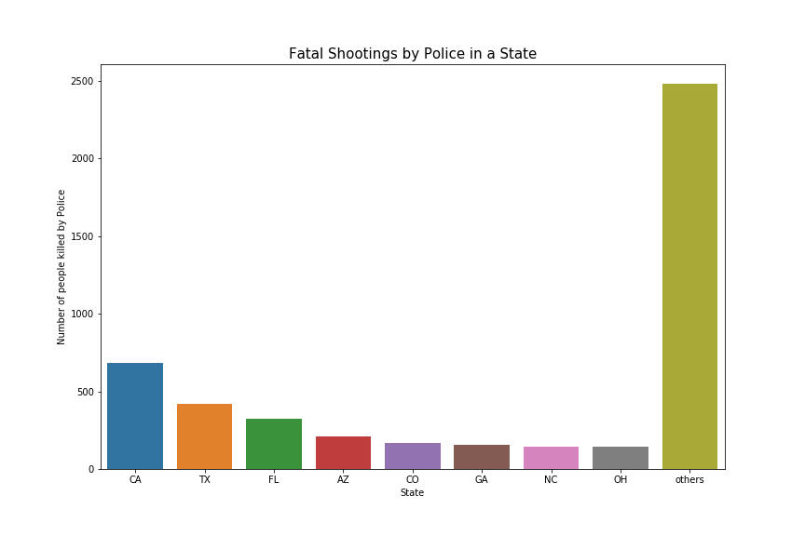
Based on State

Slide 5
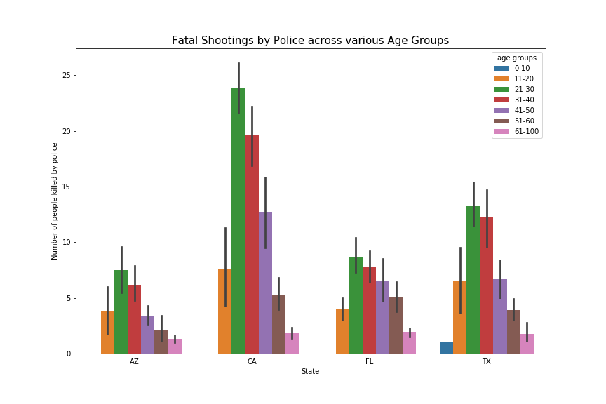

Slide 6
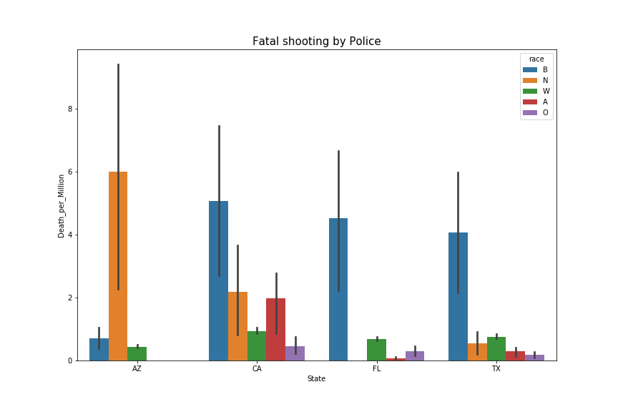

Slide 7
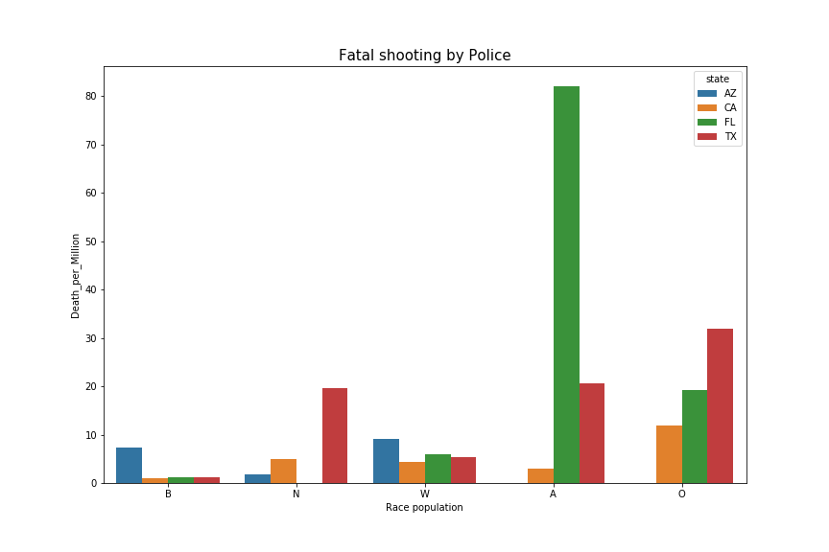

Slide 8
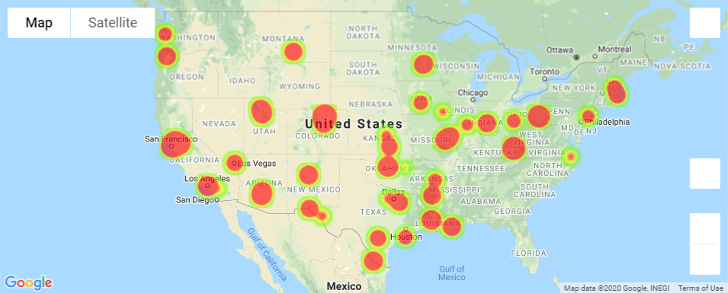

Slide 9
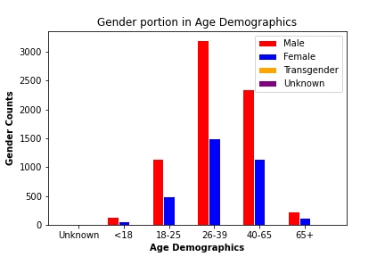
Based on Age

Slide 10
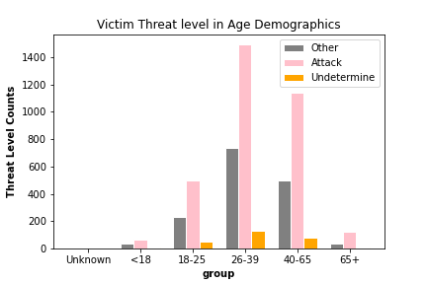

Slide 11
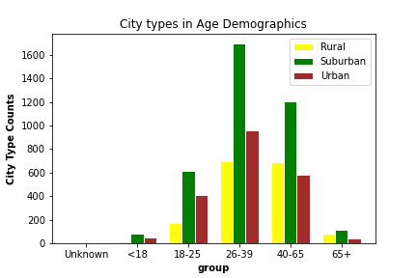

Slide 12
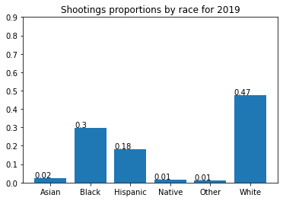
Year Trend

Slide 13
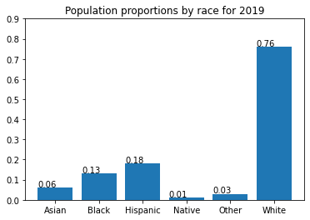

Slide 14
